Slide 1

Bellabeat capstone project
Google Data Analytics Professional Certificate Isaac Dominguez

Slide 2
Table of contents
Introduction
Purpose statement
Data
Findings
Conclusion

Slide 3


Introduction
Bellabeat is a company in the fitness industry.
Develop fitness tracking devices.
Aimed mainly to women

Slide 4
What this project is about

Slide 5
Objective
Find user trends and patterns to help improve customer support and product development.

Slide 6
dATA
Fitbit user data from 4.12.16 to 5.12.16
Individual user information on daily steps, calories and sleep time.

Slide 7
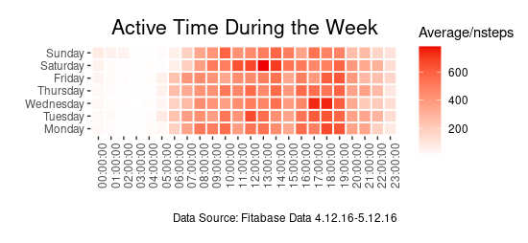
Users' Average daily ACTIVITY
Most users start their activities between 5 and 7 am every day.
User activity lowers significantly after 8 pm.
Saturdays between 11 am and 2 pm is when most active users are.

Slide 8
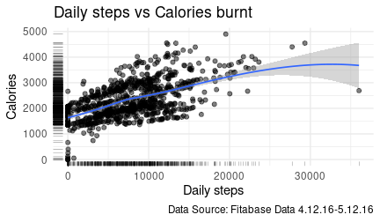
Daily steps and calories burnt
Clear correlation between daily steps taken and calories burnt per user.
As the number of steps increases, so does the calories burnt.
Important number of people who exercise at home or at the gym.

Slide 9
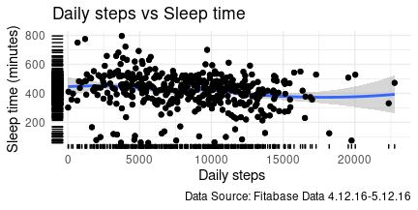
Daily stepss and sleep time
No clear correlation
The number of steps taken by an individual, does not affect their sleep time in any way.

Slide 10
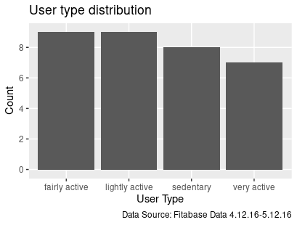
User groups
Grouping users based on their daily steps:
Sedentary: Less than 5,000 steps
Lightly active: Between 5,000 and 7,500 steps.
Fairly active: Between 7,500 and 10,000 steps.
Very active: More than 10,000 steps

Slide 11
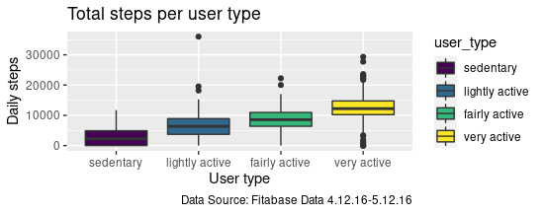
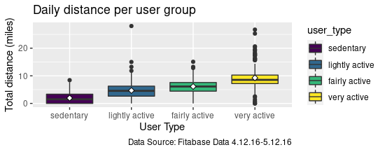
Steps and daily distance
Both steps and daily distance are correlated.
Both variables increase with each group.

Slide 12
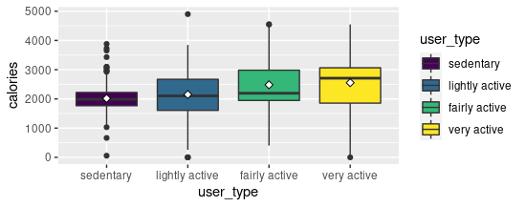
Calories and Sleep time
Similar trend as past graphs
Some outliers in the high burnt calorie spectrum, indicate that these people workout in a gym or in classes, rather than running or walking.

Slide 13
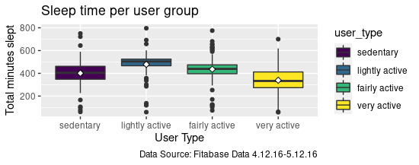
Sleep time
In the sleep time data, there is no relation when it comes to different active groups.

Slide 14
Conclusions
Promoting user activity on less active periods of time, via challenges and notifications on determined times of the day.
Basing active user classification in daily steps taken is misleading.
People who workout in other ways rather than running or walking, may be put in the wrong category. (Gym, crossfit, yoga, etc).
Improving the device’s tracking capabilities for activities other than running and walking, may improve user satisfaction.

